Slide 1

HEALTH
SERVICE
MANAGEMENT
Team:
Geetha S
Maumita Saha
Veda R Babu
Karuna B R
Turimala Srivani
Sandhya G
Varshitha K
Irvisetty Baby Sravani
Mentor: Mohammed Ishaque
Trainer: Sudheer

Slide 2

PROBLEM STATEMENT
To Create an Application Health Service Management
Customer should be able to view the homepage, services and contact details.
Admin should be able to perform all the CRUD operations.

Slide 3
ROAD MAP
Application will be developed in following Sprints –
Core Java +JPA with Hibernate
Spring Boot + Rest Controller + JPA with Hibernate
React for UI design (Front End) + Integration with previous Sprint

Slide 4
MODULES
Diet Module
Doctor Module
Patient Module
Patient Case Module
Patient History Module
Disease Module
Finance Module
Insaurance Policy module

Slide 5
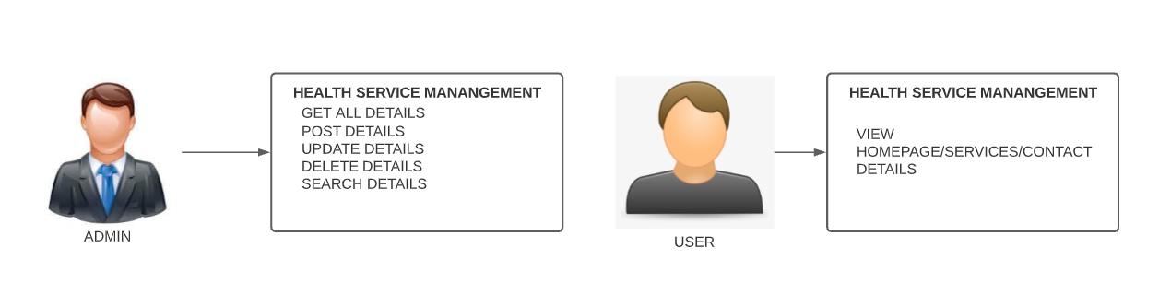
USE CASE DIAGRAM

Slide 6
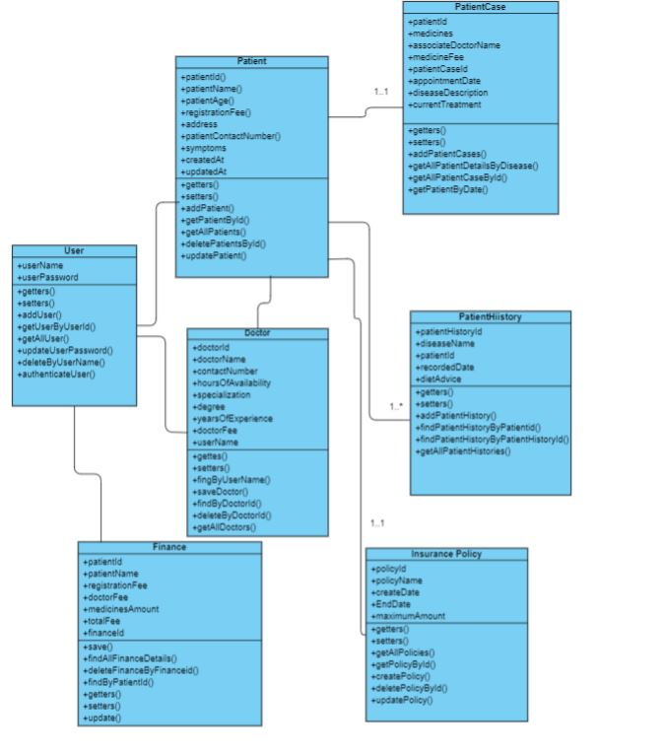
CLASS DIAGRAM

Slide 7
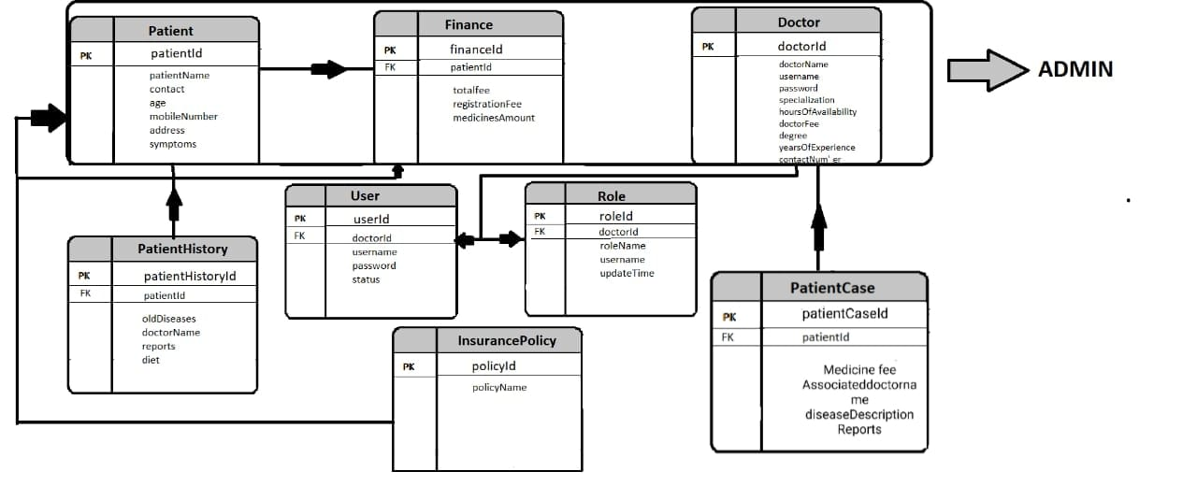
ER DIAGRAM

Slide 8
TECHNOLOGY AND TOOLS USED:
FOR PROJECT MANAGEMENT-
Gradle (Project Building Tool)
FOR MANAGING BEAN LIFE CYCLE-
Spring Web
Spring Test Framework
Spring Data JPA
Spring Devops Tools
Spring fox
FOR TESTING-
Mockito
Junit
FOR MAINTAINING LOGS-
Logger
LANGUAGE USED-
React
Bootstrap
CSS

Slide 9




QUESTIONS

